Slide 1

Diabetes Prediction Using Machine Learning Algorithms
Khandokar Zaeem Hasan- 2016-1-68-016
Swarup Mondal- 2016-2-60-145
Zakir Hossain- 2016-3-60-018
Shimanto Krishna Chakroborty- 2017-2-68-001
Moniruzzaman Shanto- 2018-1-60-075

Slide 2
Introduction
Classification strategies are broadly used in the medical field for classifying data into different classes according to some constrains comparatively an individual classifier.
This research work focuses on diabetes prediction. In this work, Naive Bayes, SVM, and Decision Tree machine learning classification algorithms are used and evaluated on the PIDD dataset to find the prediction of diabetes in a patient. Experimental performance of all the three algorithms are compared on various measures and achieved good accuracy.

Slide 3
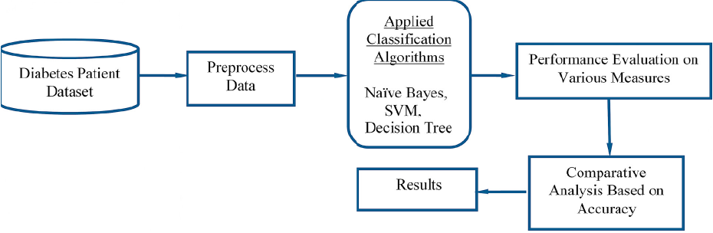
Methodology

Slide 4
Methodology
Another report has five different modules. These modules include:
I. Dataset Collection
ii. Data Pre-processing
iii. Clustering
iv. Build Model
v. Evaluation

Slide 5
Clustering
K-means clustering used on the dataset to classify each patient into either a diabetic or non-diabetic class. Before performing K-means clustering, highly correlated attributes were found which were, Glucose and Age. K-means clustering was performed on these two attributes. After implementation of this clustering we got class labels (0 or 1) for each of our record.

Slide 6
Support Vector Machine (SVM)
SVM is one of the standard set of supervised machine learning model employed in classification. the aim of a support vector machine is to find the best highest-margin separating hyperplane between the two classes. Hyperplane should be selected which is far from the data points from each category. The points that lie nearest to the margin of the classifier are the support vectors

Slide 7
Naive Bayes Classifier
Naive Bayes is a classification technique with a notion which defines all features are independent and unrelated to each other.
Using Bayes theorem posterior probability P(C|X) can be calculated from P(C),P(X) and P(X|C) .Therefore, P(C|X) = (P(X|C) P(C))/P(X)
Where,
P(C|X) = target class’s posterior probability .
P(X|C) = predictor class’s probability.
P(C) = class C’s probability being true.
P(X) = predictor’s prior probability

Slide 8
Decision Tree Classifier
Decision Tree is a supervised machine learning algorithm used to solve classification problems.
It uses nodes and internodes for the prediction and classification. In every stage, Decision tree chooses each node by evaluating the highest information gain among all the attributes .

Slide 9
Dataset Used
In this work WEKA tool is used for performing the experiment. WEKA is a software.
One of the biggest advantages of using WEKA is that it can be personalized according to the requirements. The main aim of this study is the prediction of the patient affected by diabetes using the WEKA tool by using the medical database PIDD.

Slide 10
Accuracy Measures
Naive Bayes, SVM and Decision Tree algorithms are used in this research work. Experiments are performed using internal cross-validation 10-folds. Accuracy, F-Measure, Recall, Precision and ROC (Receiver Operating Curve)measures are used for the classification of this work.
Where, TP defines True Positive, TN defines True Negative, FP defines False positive, FN defines False Negative. The corresponding classifiers performance on the basis of Accuracy, Precision, F-measure, Recall and ROC values are listed and classifier’s performance on the basis of classified instances

Slide 11

Classification Accuracy
It is the ratio of number of correct predictions to the total number of input samples.

Slide 12
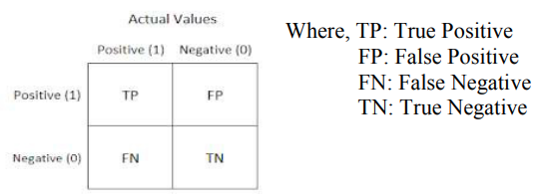

Classification Accuracy
Confusion Matrix: It gives us gives us a matrix as output and describes the complete performance of the model.
Accuracy for the matrix can be calculated by taking average of the values lying across the main diagonal. It is given as-

Slide 13
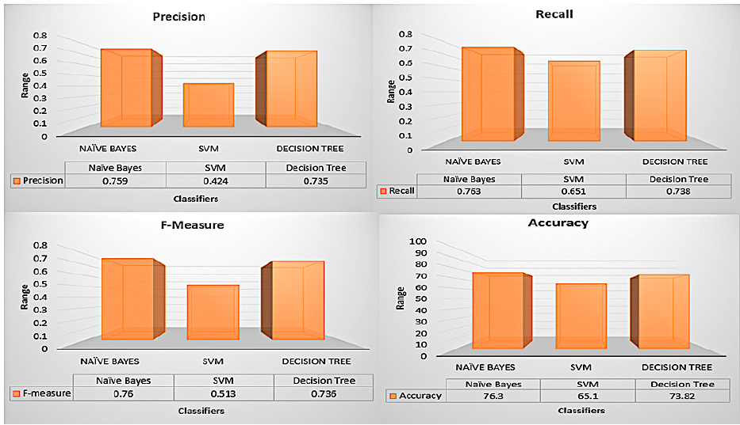
Results
The Naive Bayes machine learning classifier can predict the chances of diabetes with more accuracy as compared to other classifiers.

Slide 14
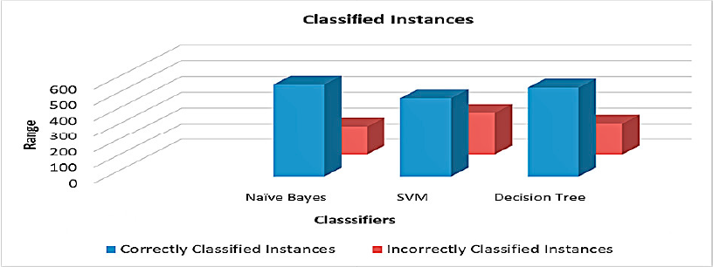
According to these classified instances, accuracy is calculated and analyzed. Performance of individual algorithm is evaluated on the basis of Correctly Classified Instances and Incorrectly Classified Instances out of a total number of instances. Naive Bayes algorithm is considered as the best supervised machine learning method of this experiment because it gives higher accuracy in respective to other classification algorithms with an accuracy of 76.30 %.

